Slide 1
NAME : JANNATHUL HALFIA M
REGISTOR NO : 24131210500122018
NM ID : 24131210500122018
DEPARTMENT :2nd BCA
COLLEGE : IMMACULATE COLLEGE FOR WOMEN

Slide 2
PORTFOLIO

Slide 3
AGENDA
1. problem statement
2.Project overview
3.End user
4.Tools and Technologies
5.Portfolio
6.Features and Functionality
7.Results and Screenshots
8.Conclusion
9.Github link

Slide 4
Problem statement
Describe the problem or
challenge you aimed to solve with your portfolio/project. For example, "Creating a visually appealing and user-friendly portfolio to showcase
my skills and experience as a
student editor."

Slide 5
Project Overview
Describe the problem or challenge you aimed to solve with your portfolio/project. For example, "Creating a visually appealing and user-friendly portfolio to showcase my skills and experience as a student editor.".

Slide 6
End Users
Identify the target audience for your portfolio. For example, "Potential employers, clients, or collaborators who want to learn more about my skills and experience.".

Slide 7
Tools and Technologies
A List the tools and technologies you used to build your portfolio. For example, "HTML, CSS, JavaScript, and design tools like Adobe Photoshop."

Slide 8
Portfolio design and Layout
About a student portfolio ,
the details for the student ,
who creates the port folio.

Slide 9
Features and Functionality
An explanation of the key features and functionalities of the project.

Slide 10
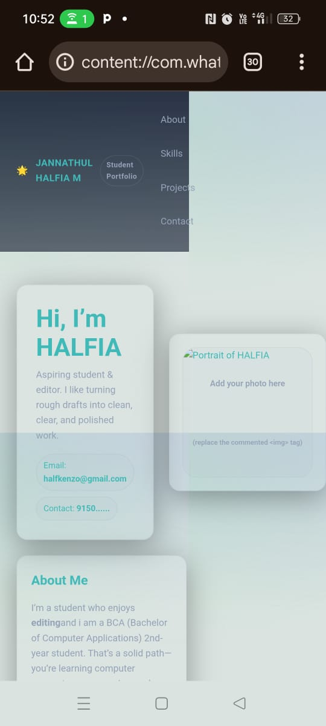
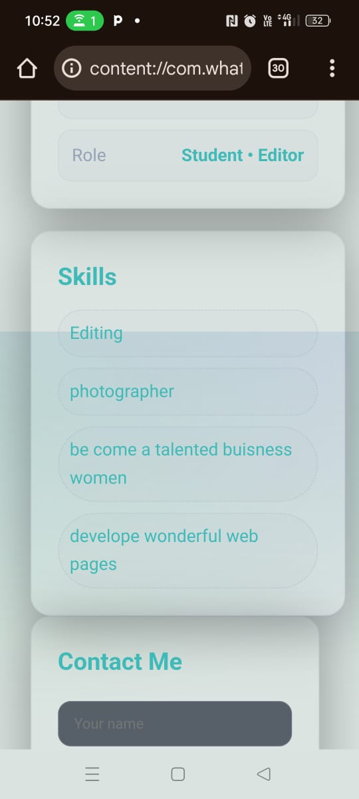
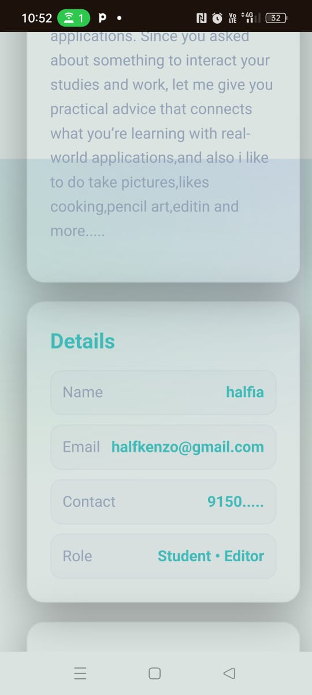
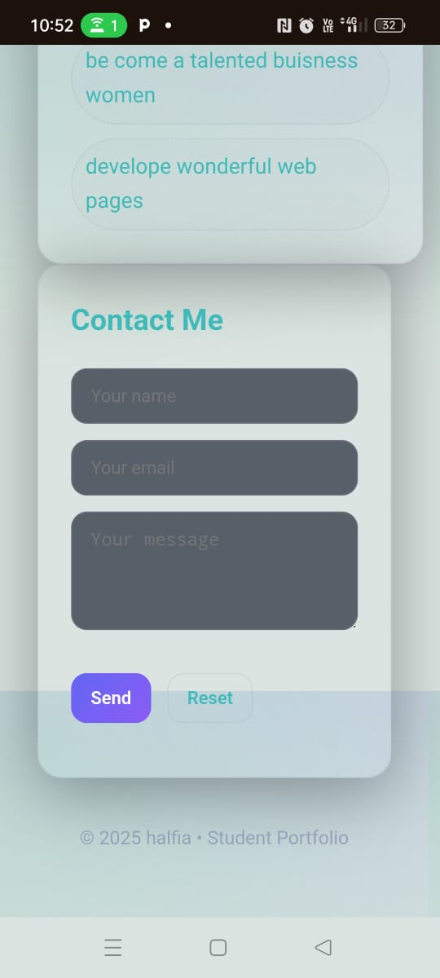
Results and Screenshots
"C:\Users\HALFIA\Desktop\portfolio\BBindex.html“

Slide 11
Conclusion
Finally create a students portfolio by myself and it’s a wonderful experience.

Slide 12
Github Link
https://github.com/halfiyakenzo-gif/Halfiya-TNSDC-FWD-DP

